Slide 1

Problem Solving Session
The remainder of today’s class will comprise the problem solving session (PSS).
Your instructor will divide you into teams of 3 or 4 students.
Each team will work together to solve the following problems over the course of 20-30 minutes.
You may work on paper, a white board, or digitally as determined by your instructor.
You will submit your solution by pushing it to GitHub before the end of class.
Your instructor will go over the solution before the end of class.
If there is any time remaining, you will begin work on your homework assignment.
Class participation is a significant part of your grade (20%). This includes in class activities and the problem solving session.
Your Course Assistants will grade your participation by verifying that you pushed your solutions before the end of the class period each day.

Slide 2

Problem Solving Team Members
Record the name of each of your problem solving team members here.
Do not forget to add every team member’s name! Your instructor (or course assistant) may or may not use this to determine whether or not you participated in the problem solving session.

Slide 3
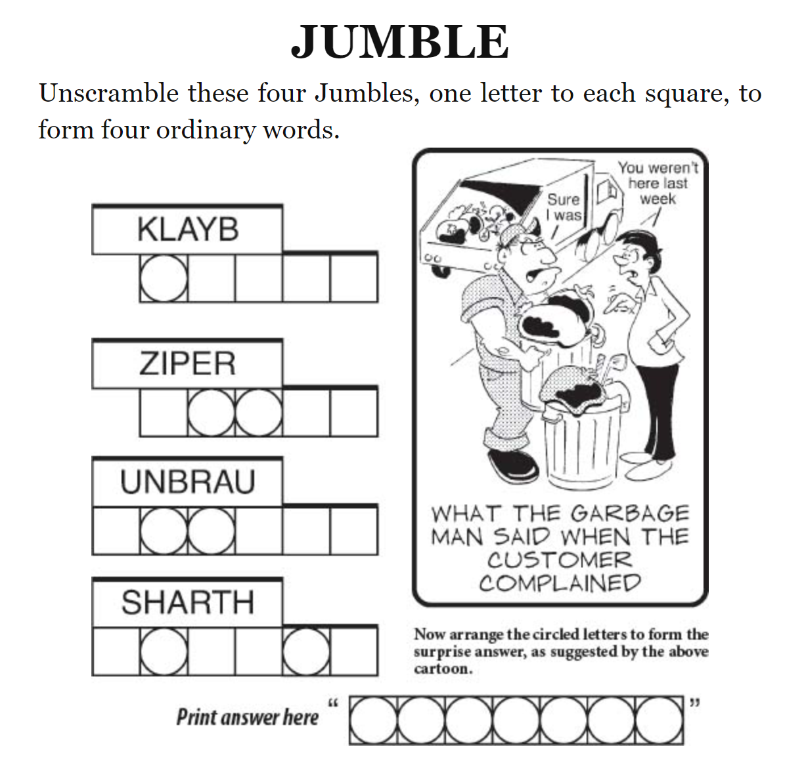
Jumbles
A Jumble is a word puzzle that presents users with a clue (usually a bad pun).
The player is challenged to unscramble four words.
The unscrambled words are usually relatively common words.
Some of the letters in each of the unscrambled words are circled. If the player guesses the correct word, these circled letters will be part of a fifth scrambled word.
Once unscrambled, the fifth and final word is the answer/punchline to the Jumble's clue/pun.
b a l k y
P r i z e
a u b u r n
t h r a s h
r u b b i s h

Slide 4
Problem Solving 1
Assume that you have a text file that contains words in the English language, with each word on a separate line, e.g.
Ate
Eat
Loot
Tea
Tool
We want to eliminate variations in the case of the letters (so that words like "Auburn" and "UNBRAU" will be considered matches). Make sure to convert each string to lowercase before adding it to the list, e.g. lower_case = a_string.lower()
Write a function that, given the name of such a file, returns a list of the words in the file.

Slide 5
Problem Solving 2
The challenge of a Jumble lies in unscrambling words. This requires that, given a string of letters, you find words that contain exactly the same letters (though obviously they will be in a different sequence).
One technique that works well is to sort the letters in both words and compare the two. If the sorted strings are identical, then the words must contain the same letters.
In the space to the write, implement a function that declares a parameter for a string and returns the sorted version of the string. For example, if called with the string "racecar" it will return the string "aaccerr".
Hint: you can use the built-in sorted() function to create a sorted list of letters from a string.

Slide 6
Problem Solving 3
def build_words(word_list):
You can determine if two strings contain the same characters by sorting the strings and comparing them. For example "ate", "eat", and "tea" all sort to "aet".
Write a function that, given a list of words, builds a dictionary where each key is the sorted word and each value is a list of words that contain those letters.
For example, given the the following list of words:
["ate", "eat", "loot", "tea", "tool"]
Your dictionary should contain the following key/value pairs:
{ "aet" : ["ate", "eat", "tea"],
"loot" : ["loot", "tool"] }

Slide 7
Problem Solving 4
def unscramble(scrambled, words):
Some scrambled words have only one possible answer, e.g. the only English word that has the same letters as "SHARTH" is "THRASH".
Others have multiple possible matches, e.g. both "PEIRZ" AND "PRIZE" match the scrambled word "ZIPER".
Write a function that, given a scrambled word and your dictionary of words, finds the words in your dictionary with the same letters. If there is only one match, return it.
If there are multiple matches, print each one and prompt the user to choose the correct word, e.g.
0. pierz
1. prize
Enter the index of the word:

Slide 8
Problem Solving 5
Once the four scrambled words have been unscrambled, the circled characters in each word are combined to create a fifth scrambled word.
Write a function that prompts the user to enter a word followed by 1 or more indexes. Return a string comprising only the characters at those indexes.
for example, if the user enters:
bucket 1 2 4
Your function should return the string comprising the characters at indexes 1, 2, and 4, i.e. "uce".

